Slide 1
OL13
1st Line Maintenance – Opal Top Up and Single Trip Ticket Machine
Version 1.1
Notes:
NOTE TO CURRICULUM DEVELOPER: REFER TO QTMS-PR-39 CURRICULUM DEVELOPMENT GUIDE ON THE USE OF THIS TEMPLATE.

Slide 2
Course Outline
Purpose statement / Objective
This course aims to equip participants with the required knowledge and skills to be able to undertake 1st line maintenance of Opal Top Up and Single Trip Ticket machines.
Learning Outcomes
At the end of the course, participants will have learned how to:
Describe the correct procedure for routine exterior cleaning
Explain how to log in to the Opal Top Up and Single Trip Ticket machine maintenance software
Explain how to check the status of consumables
Describe how to open the Opal Top Up and Single Trip Ticket machine
Identify hardware components of the Opal Top Up and Single Trip Ticket machine
Describe how to replenish the paper receipt roll

Slide 3
Course Outline
Describe how to replenish Single Trip Tickets
Explain how to close and lock Opal Top Up and Single Trip Ticket machines.
Assessment
Participants will need to complete the following assessment:
Practical Observation Assessment.

Slide 4
Housekeeping
Mobile Phone Use
Evacuation Plan
Facilities
Put on Silent
Refer to wall chart in classroom
Location of main facilities
CCTV camera – filmed whilst on premises
Smoking – not on property
First Aid – box locations / officer on duty / defibrillator

Slide 5
Housekeeping
General housekeeping
Administration
Drug and Alcohol Policy (applicable to STA and TfNSW Staff) – You may be tested at any time
Injuries and Incidents – For all injuries and incidents that occur while at training, they must inform the following:
Training Facilitator
Supervisor
Reporting
RMS Injury Hotline – 1300 131 469
STA complete Form 178 Injury / Incident Form
TfNSW Injury Hotline – 1800 772 779
Reasonable Adjustment:
Transport for NSW will treat each request for an adjustment because of a disability objectively and make any adjustments that are reasonable, necessary and possible. (Refer to Facilitator guide for full details)
Training Record Sheets

Slide 6
Topics we’re covering today
1
Topic 1: Routine exterior cleaning
2
Topic 2: Log in to Opal Top Up and Single Trip Ticket Machine maintenance software
3
Topic 3: Check status of consumables
4
Topic 4: Open Top Up and Single Trip Ticket Machines

Slide 7
Topics we’re covering today
5
Topic 5: Replenish paper receipt roll
6
Topic 6: Replenish Single Trip Tickets
7
Topic 7: Close and lock Opal Top Up and Single Trip Ticket Machines
8
Topic 8: Assessment

Slide 8
Opal Top Up and Single Trip Ticket Machines
The Opal Top Up and Single Trip Ticket Machine is an automated ticket payment machine which comes in two styles:
The Galexio Machine which allows customers to top up their Opal cards using credit/debit cards, buy Single Trip Tickets and view their Opal card balance.
The Astreo Machine which allows customers to top up their Opal cards using cash or credit/debit cards, buy Single Trip Tickets and view their Opal card balance.
There are slight differences in how you will perform your tasks and these will be highlighted throughout the training.

Slide 9
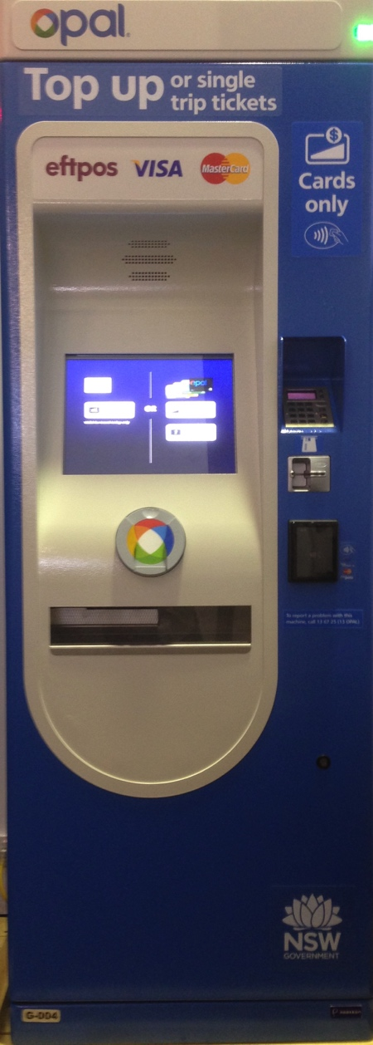
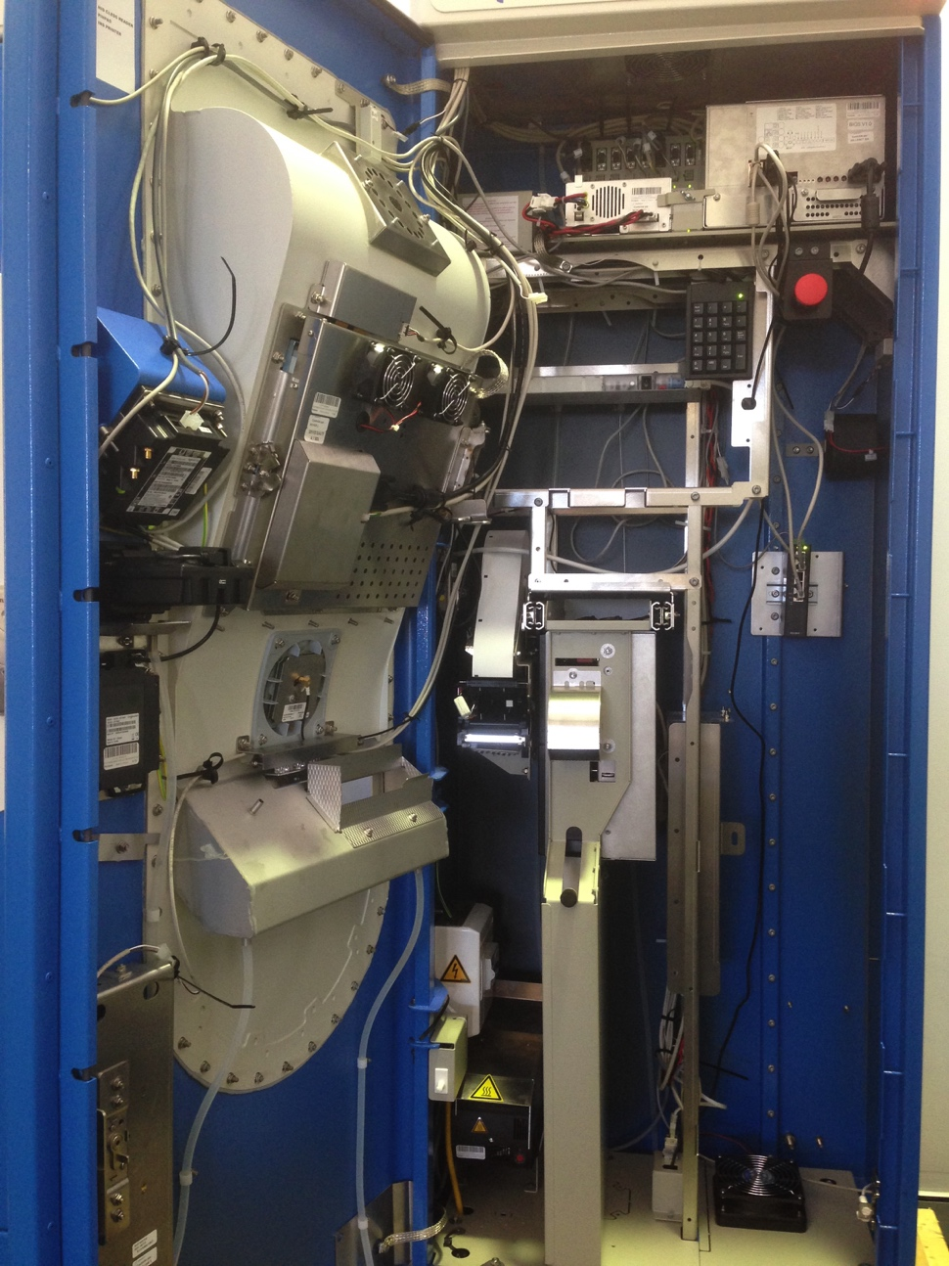
Galexio Opal Top Up and Single Trip Ticket Machine
Exterior
Interior

Slide 10
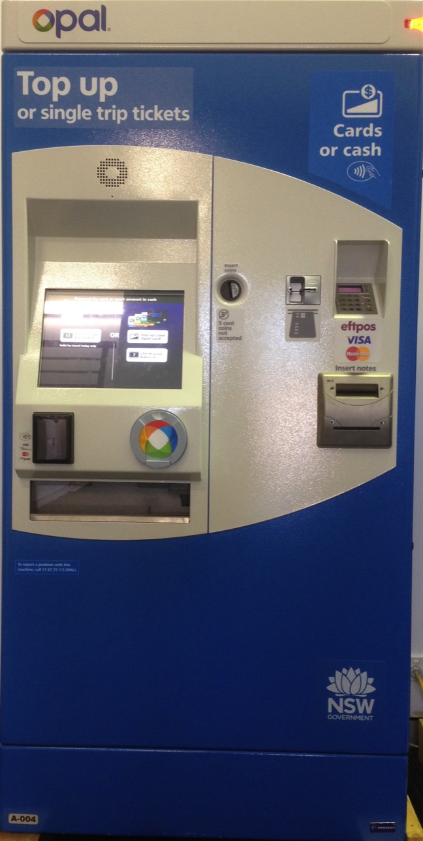
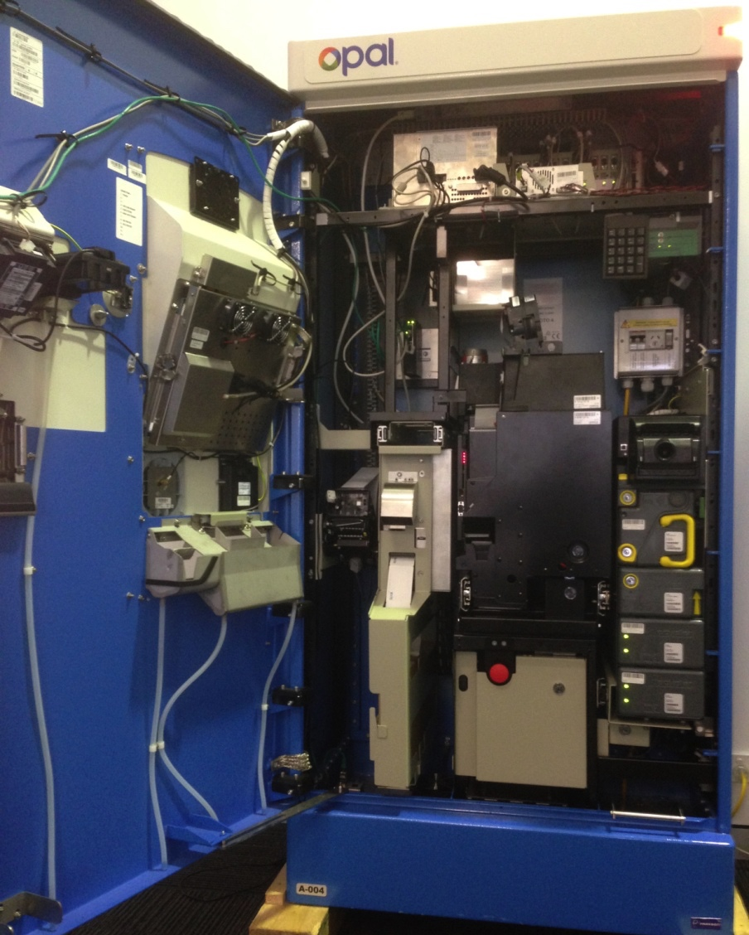
Astreo Opal Top Up and Single Trip Ticket Machine
Exterior
Interior

Slide 11
TOPIC 1
Routine exterior cleaning

Slide 12
Clean exterior of Opal Top Up and Single Trip Ticket Machine
Complete visual check of machine cleanliness
Assess cleaning requirements for dust, grime or graffiti
Clean dust with an air Duster or cleaning cloth
Clean grime and graffiti with anti-static cleaning foam spray such as Carterclene

Slide 13
TOPIC 2
Log in to Opal Top Up and Single Trip Ticket Machine maintenance software

Slide 14
Engineering Maintenance Software Login/Access
The staff member must have the following to enable access to the Engineering Maintenance Software (EMS) on the Opal Top Up and Single Trip Ticket Machine:
The door lock key
Latch lifting tool for Astreo Machine
4-digit Agent Number
4-digit Secret Code

Slide 15
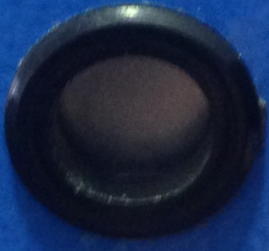
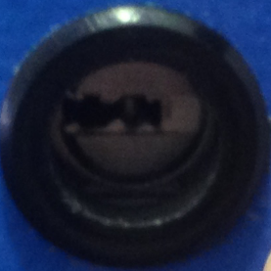
Log In – Galexio Machine
Push latch down on the top right hand inside of the paper receipt tray to allow the lock to be visible (see inset – latch is “flush” against the frame)
Not visible
Visible

Slide 16
Log In – Galexio Machine
Insert key into lock and turn left 90 degrees* until the keypad is shown on the display ** If opening the door is required, a 180 degree turn will fully unlock the lock

Slide 17
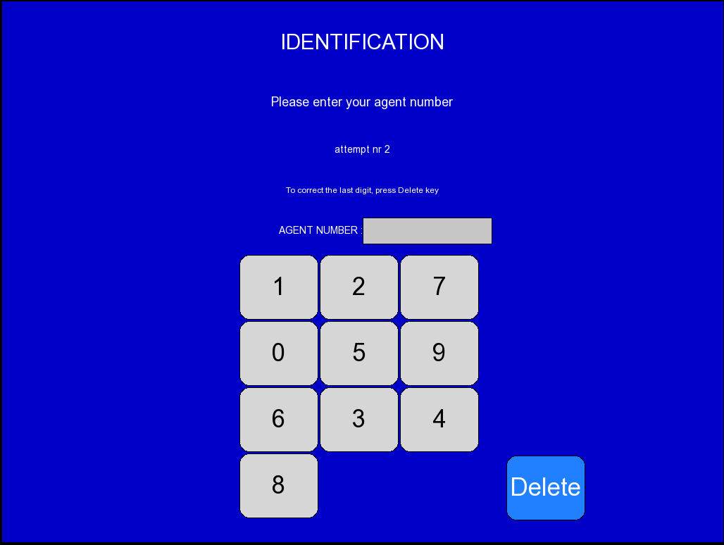
Log In – Galexio Machine
The Opal Top Up and Single Trip Ticket Machine prompts the staff member to enter their 4-digit AGENT NUMBER The number positions are dynamic – they move each time a digit is pressed.

Slide 18
Log In – Galexio Machine
The Opal Top Up Machine prompts the staff member to enter their 4-digit SECRET CODE Note: Three attempts are allowed to enter the correct pair of codes before an alarm is sounded.

Slide 19
Log In – Galexio Machine
The Opal Top Up Machine will display Servicing – Maintenance is starting...

Slide 20
Log In – Galexio Machine
If sign-on is successful, the Opal Top Up and Single Trip Ticket Machine displays the MAINTENANCE Software screen (main menu)

Slide 21
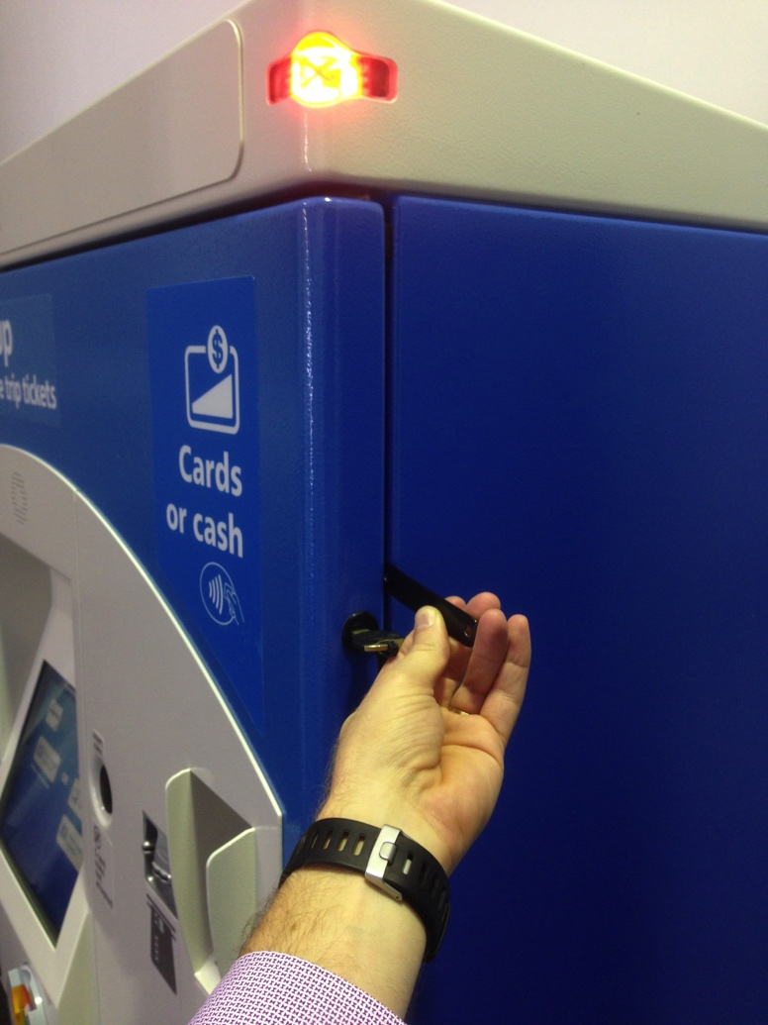
Log In – Astreo Machine
On top lock*, use the supplied tool to raise latch to allow the lock to be visible
Insert key into lock and turn left 90 degrees** until the keypad is displayed
Not visible
Visible
*Always open the top lock first
** If opening the door is required, a 360 degree turn will fully unlock the lock

Slide 22
Log In – Astreo Machine
The Opal Top Up and Single Trip Ticket Machine prompts the staff member to enter their 4-digit AGENT NUMBER The number positions are dynamic – they move each time a digit is pressed.

Slide 23
Log In – Astreo Machine
The Opal Top Up Machine prompts the staff member to enter their 4-digit SECRET CODE Three attempts are allowed to enter the correct pair of codes before an alarm is sounded.

Slide 24
Log In – Astreo Machine
The Opal Top Up Machine will display Servicing – Maintenance is starting...

Slide 25
Log In – Astreo Machine
If sign-on is successful, the Opal Top Up and Single Trip Ticket Machine displays the MAINTENANCE Software screen (main menu)
Remove key and stow in a safe place

Slide 26
TOPIC 3
Check status of consumables

Slide 27
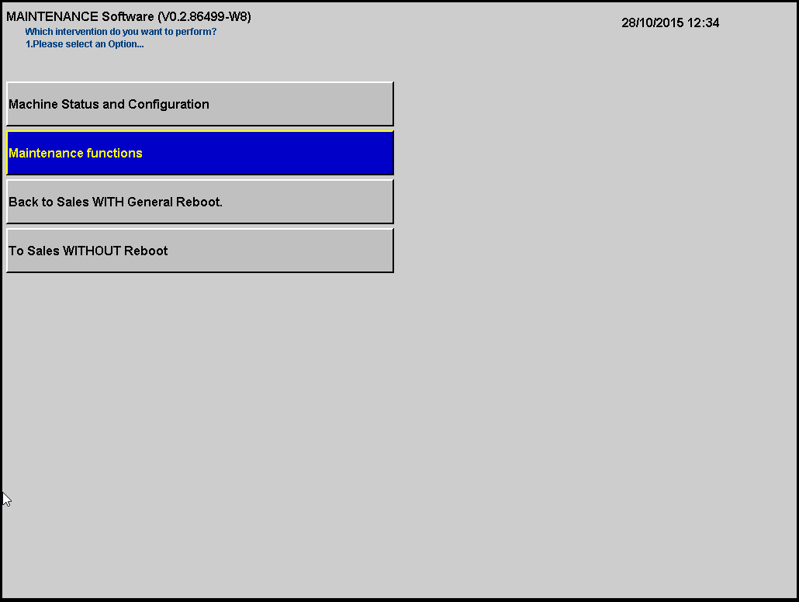
Check consumables for Paper Receipt Status
Select Maintenance Functions

Slide 28
Check consumables for Paper Receipt Status
Select Maintenance of Iml5 printer The IML5 printer is the paper receipt printer

Slide 29
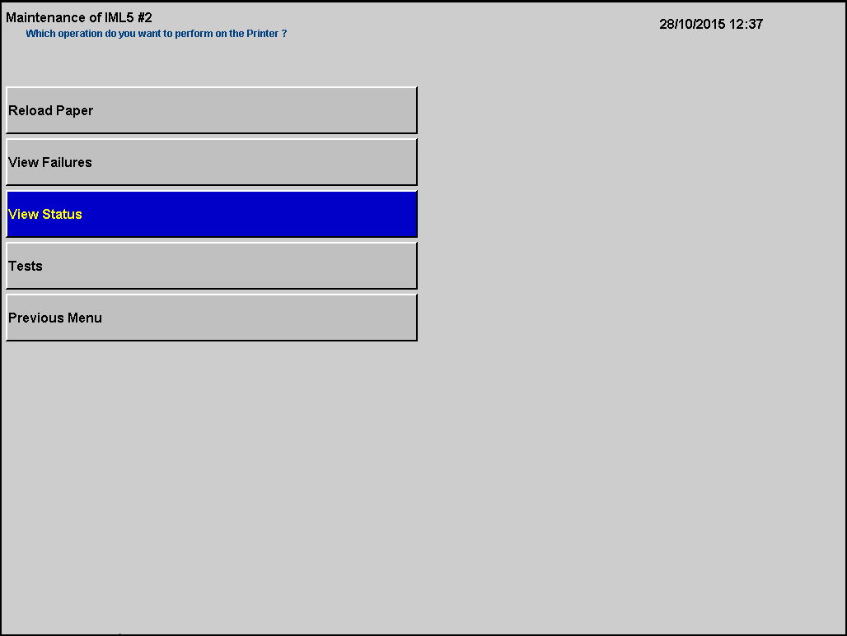
Check consumables for Paper Receipt Status
Select View Status

Slide 30
Check consumables for Paper Receipt Status
Status displays. In this example Stock=381886mm
Touch anywhere to return to previous menu
Select Previous Menu
Select Previous Menu

Slide 31
Check Consumables for Single Trip Ticket Status
Select Maintenance Functions

Slide 32
Check Consumables for Single Trip Ticket Status
Select Maintenance of Ims printer IMS Printer is the Single Trip Ticket printer

Slide 33
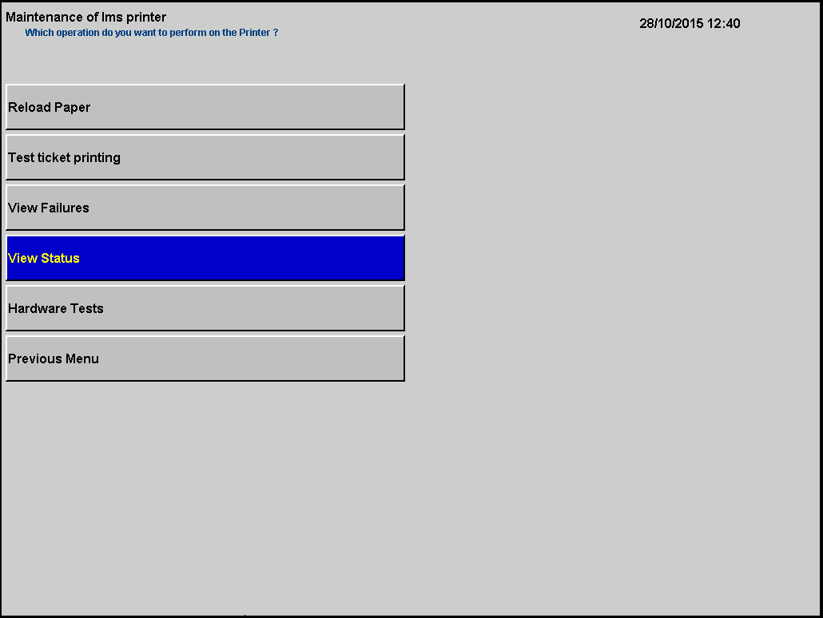
Check Consumables for Single Trip Ticket Status
Select View Status

Slide 34
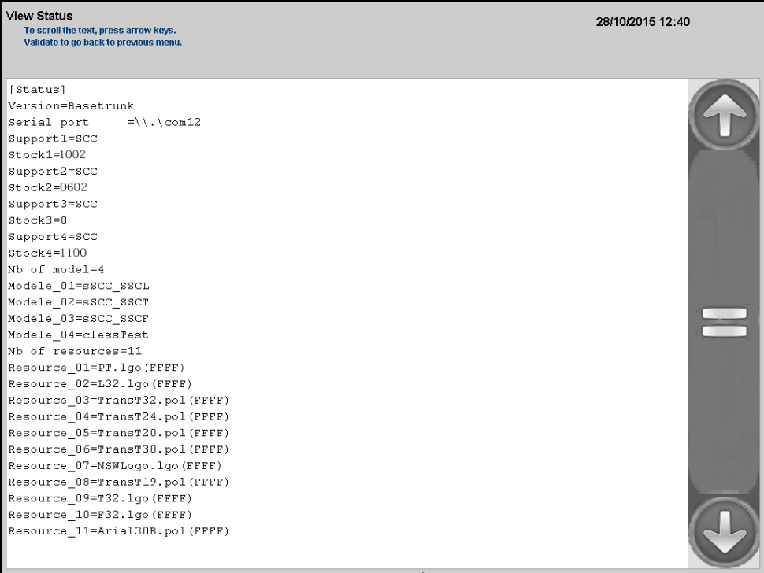
Check Consumables for Single Trip Ticket Status
Status displays. In this example Stock1=1002 tickets left in the box.
Press anywhere to return to previous menu.
Select Previous Menu.
Select Previous Menu.
Note full stock for each box is 1200 tickets.

Slide 35
TOPIC 4
Open Top Up and Single Ticket Machines

Slide 36
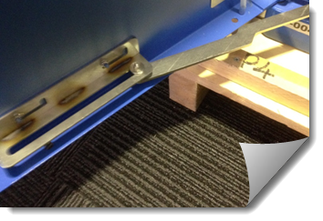
Open the Galexio Machine
Open the door until the bracket clicks into place at the base of the door
Remove the key and stow in a safe place

Slide 37
Open the Astreo Machine
Remove the key from the top lock if not already done so
Use the supplied tool to raise up the latch for the bottom lock

Slide 38
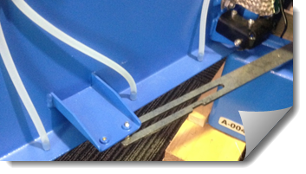
Open the Astreo Machine
Insert key into keyhole and turn fully anti-clockwise to unlock the bottom four bolts
Open the door until the latch clicks at the base of the door
Remove key and stow in a safe place

Slide 39
Open the display inside
Unlatch the display by pressing the lever down and lifting slightly over latch and open fully

Slide 40
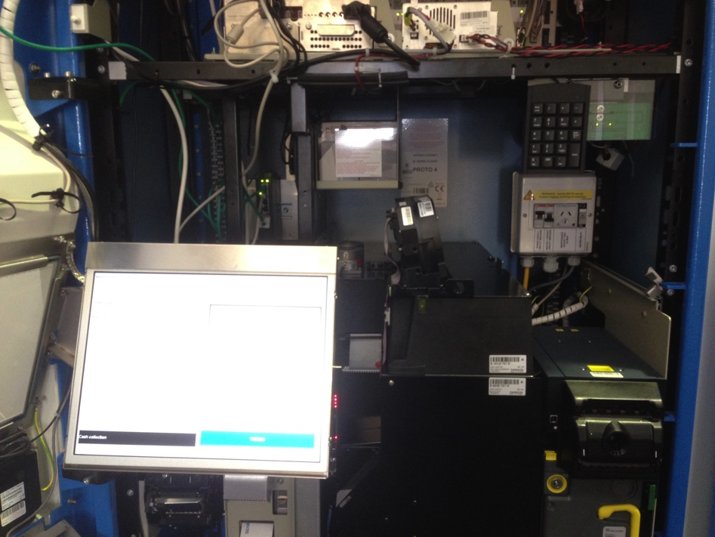
Open the display inside
Display is now visible while working inside Use the key pad whilst display is open, using the arrow keys to navigate and Enter to confirm.

Slide 41
TOPIC 5
Hardware components of the Opal Top Up and Single Trip Ticket Machines

Slide 42
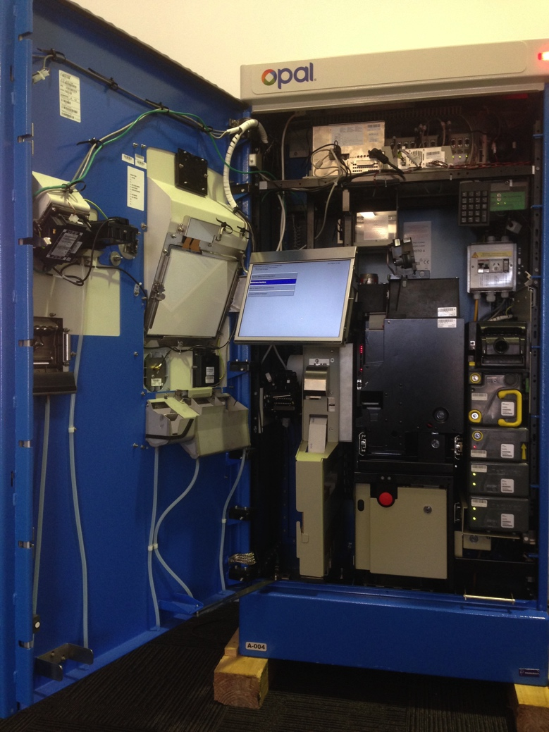
Door
The door bracket (1) secures the door in the open position
The display (2) opens while the door is open by pressing the latch
Use the keypad (3) to operate the display while the display is open
3
2
1

Slide 43
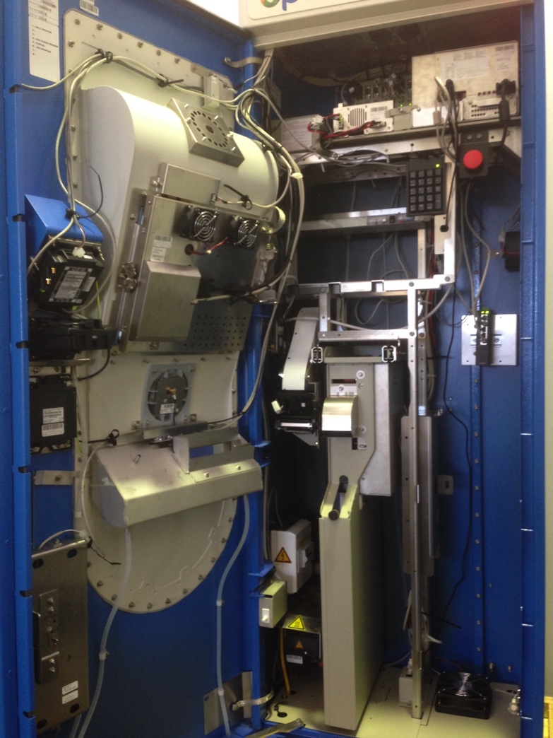
Receipt Printer
Paper receipt printer (1) is located on the left hand side, with the paper receipt roll placed on top
1

Slide 44
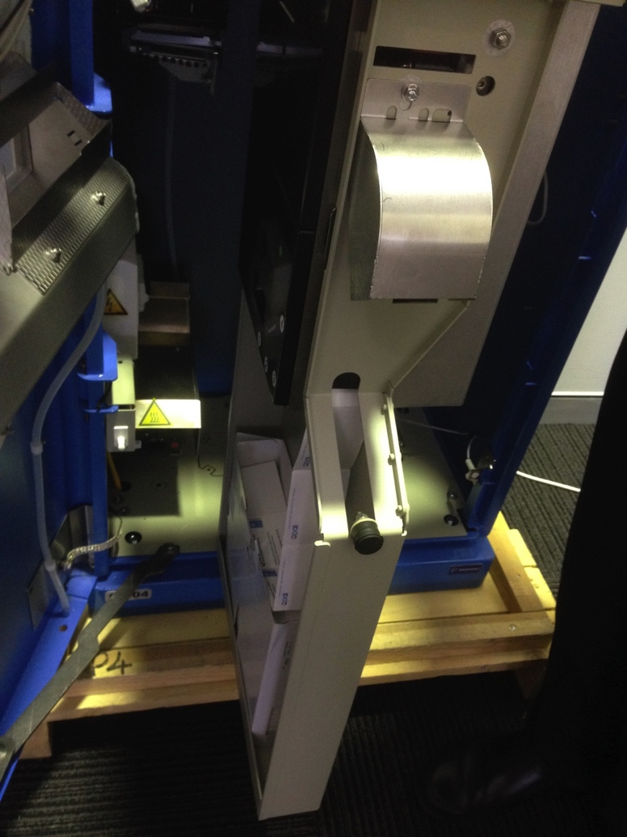
Single Trip Ticket Printer
The single trip ticket printer (1) is directly to the right of the paper receipt printer
Blank tickets (2) are loaded through ticket slots under the printer
1
2

Slide 45
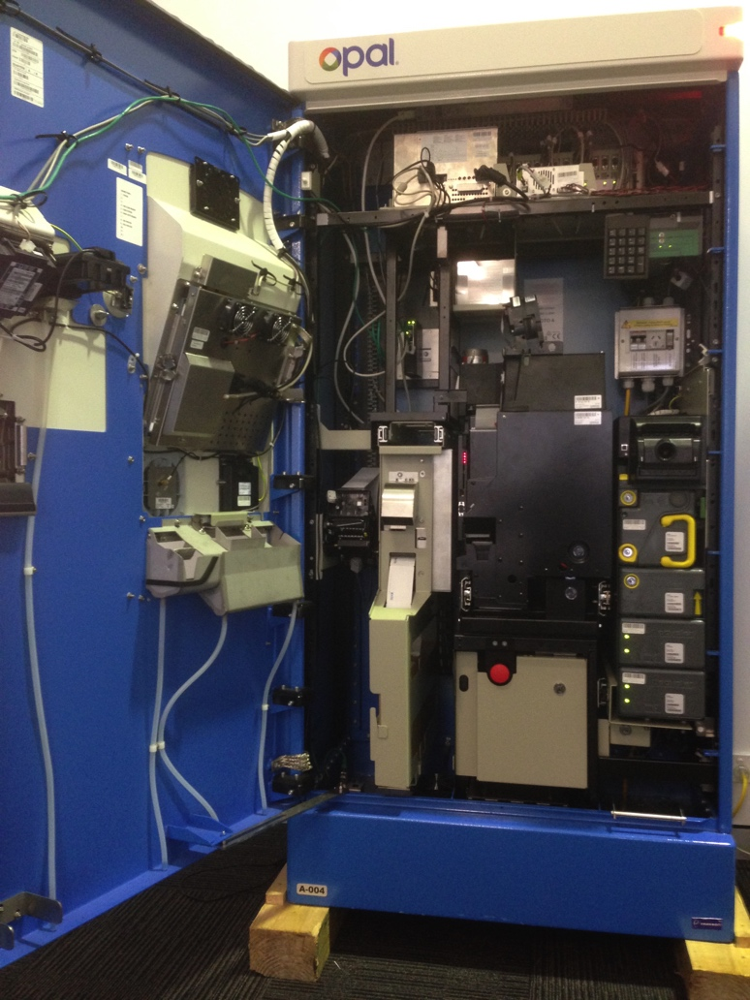
Coin Module (Astreo Machine only)
The coin hopper (1) holds and dispenses coins
The coin vault (2) stores coins for collection by Cash Collection Agents
1
2

Slide 46
Note Module (Astreo Machine only)
The note reader (1) receives and scans notes to determine denomination
The note vault (2) stores notes
The note loader (3) replenish note recyclers
Note recyclers (4) dispense notes
1
2
3
4

Slide 47
Duress Alarm - Galexio Machine
Press alarm (1) if under threat or a robbery is underway Alarm will operate for time predetermined by Transport for NSW
1

Slide 48
Duress Alarm - Astreo Machine
Press alarm (1) if under threat or a robbery is underway Alarm will operate for time predetermined by Transport for NSW
1

Slide 49
TOPIC 6
Replenish paper receipt roll

Slide 50
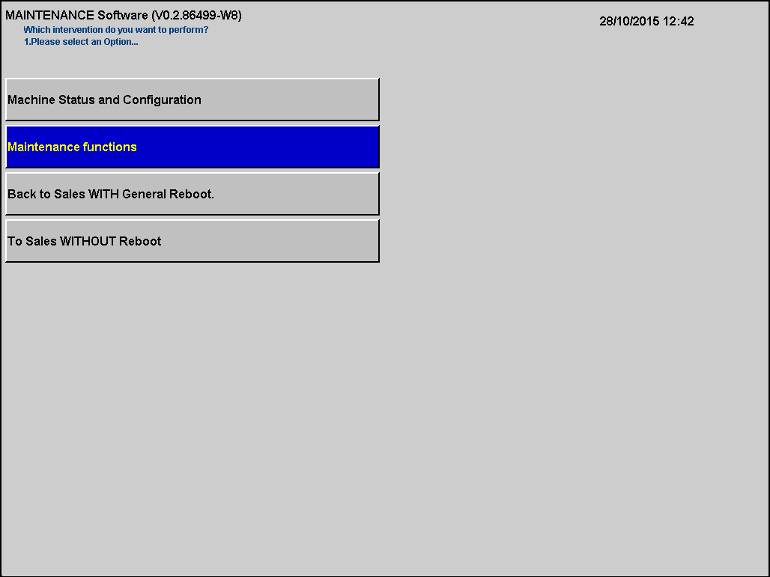
Replenish paper receipt roll - Galexio Machine
Select Maintenance Functions

Slide 51
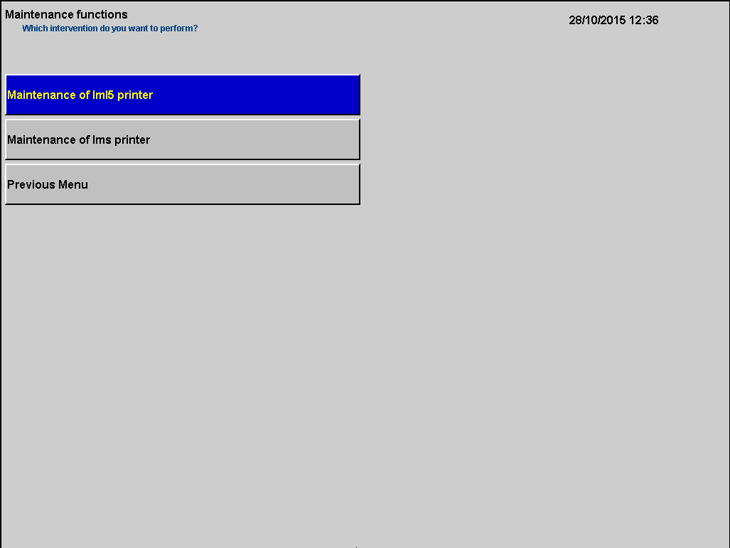
Replenish paper receipt roll - Galexio Machine
Select Maintenance of Iml5 printer The IML5 printer is the paper receipt printer

Slide 52
Replenish paper receipt roll - Galexio Machine
Select Reload Paper

Slide 53
Replenish paper receipt roll - Galexio Machine
Select Support RECEIPT (RECEIPT)

Slide 54
Replenish paper receipt roll - Galexio Machine
The Opal Top Up and Single Trip Ticket Machine will display the Support RECEIPT (RECEIPT) IML5 screen
Now it is time to access the IML5 (paper receipt) printer
Lock display back into place

Slide 55
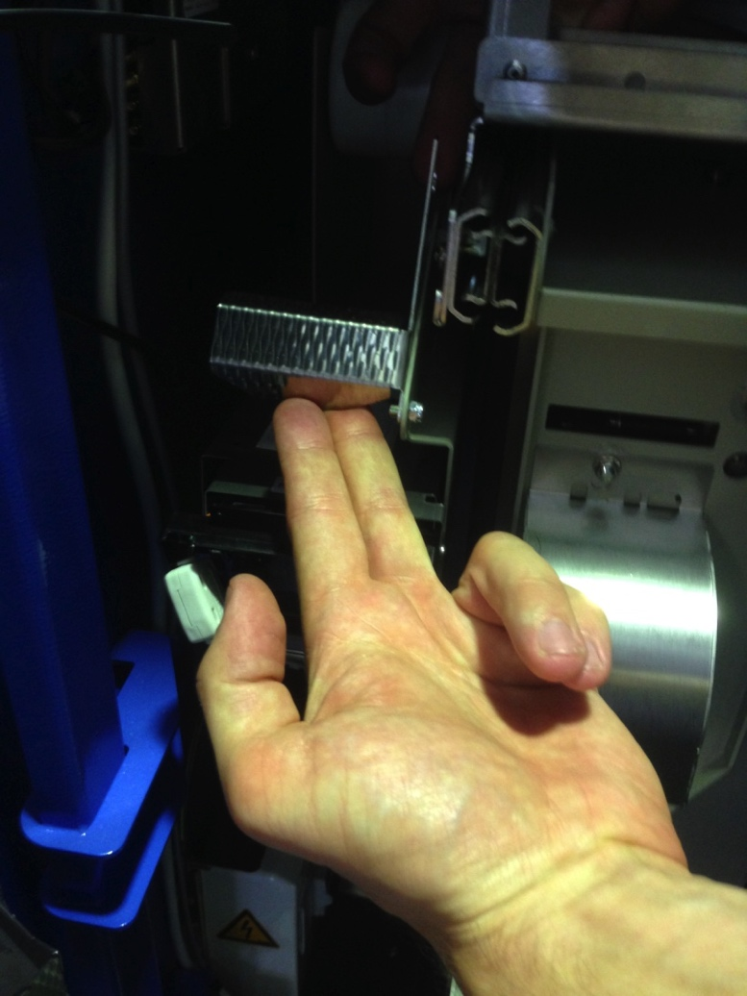
Replenish paper receipt roll - Galexio Machine
Pull out paper from printer
Lift up silver paper guide in front of paper receipt roll spindle

Slide 56
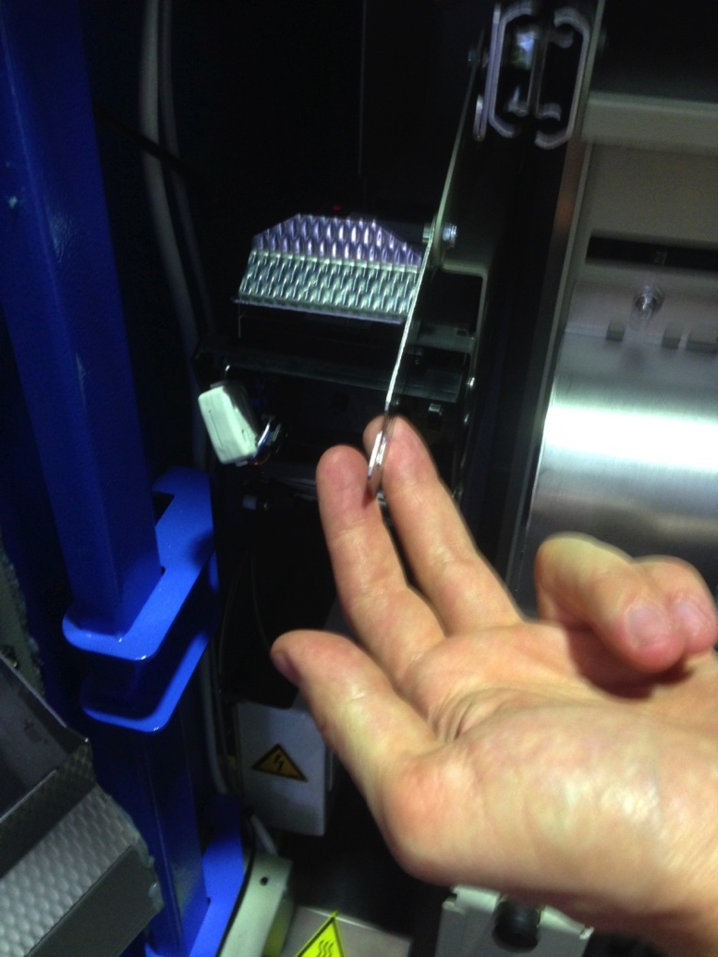
Replenish paper receipt roll - Galexio Machine
Once the silver paper guide is pushed up you can now rotate the metal paper guide downwards and towards you
The paper receipt roll is now able to be removed
Remove the empty spindle and remove the empty paper receipt roll from it

Slide 57
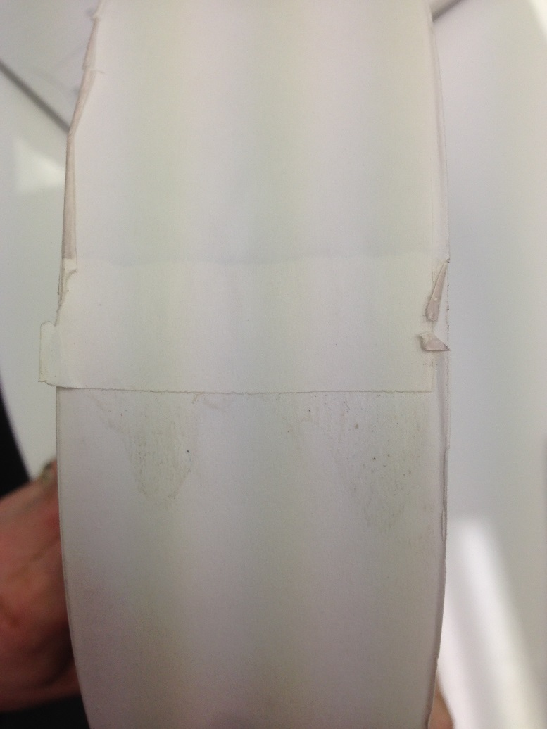
Replenish paper receipt roll - Galexio Machine
Unpack new paper receipt roll and tear off the first layer or so to ensure that there is no glue or sticky residue on the paper

Slide 58
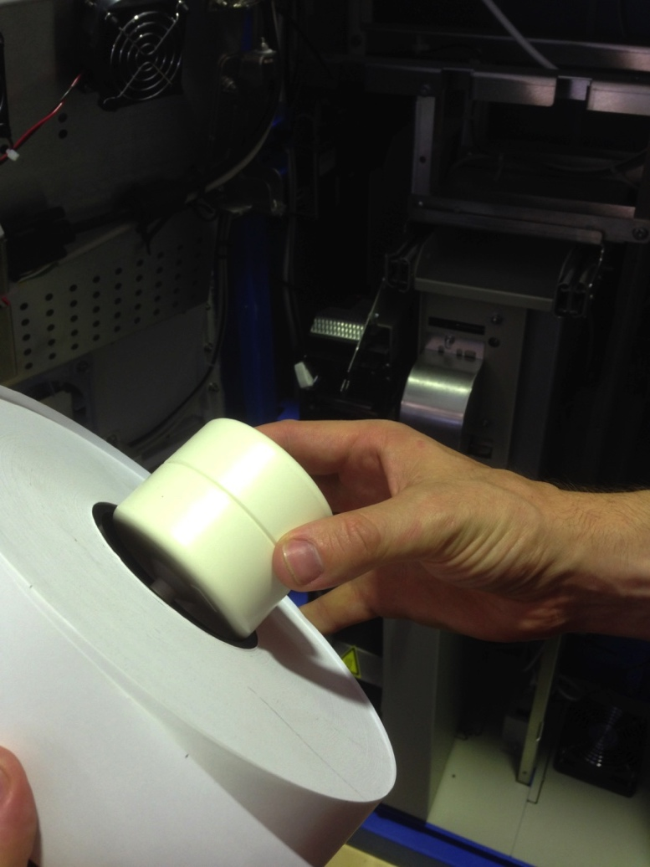
Replenish paper receipt roll - Galexio Machine
Insert spindle into new paper receipt roll

Slide 59
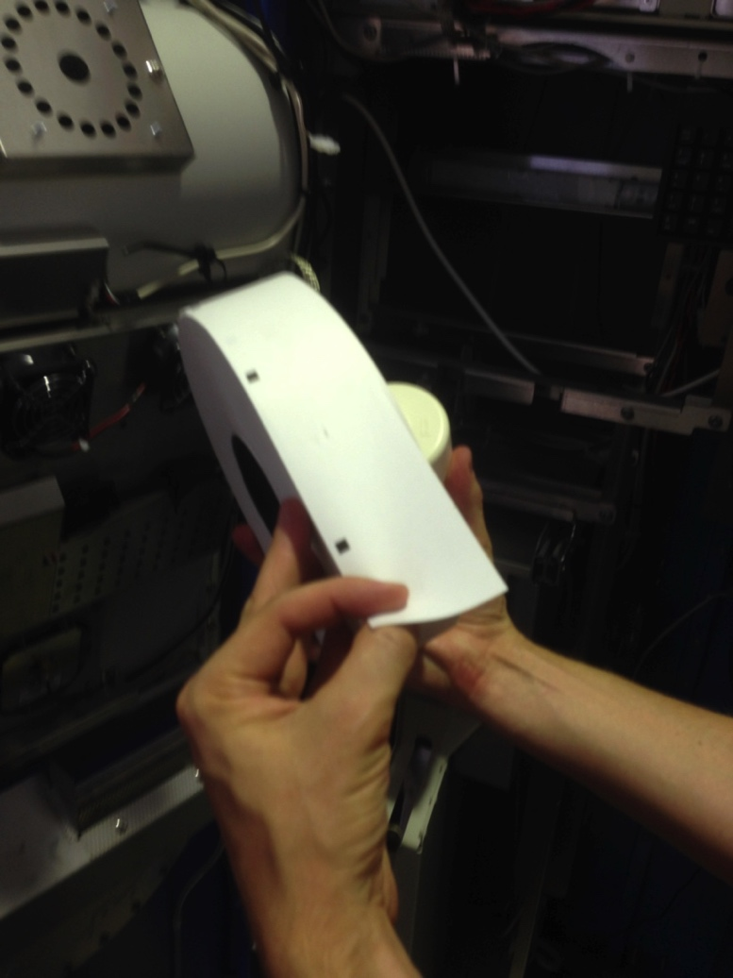
Replenish paper receipt roll - Galexio Machine
Ensure the replacement paper receipt roll end is facing forward and feeding from the top

Slide 60
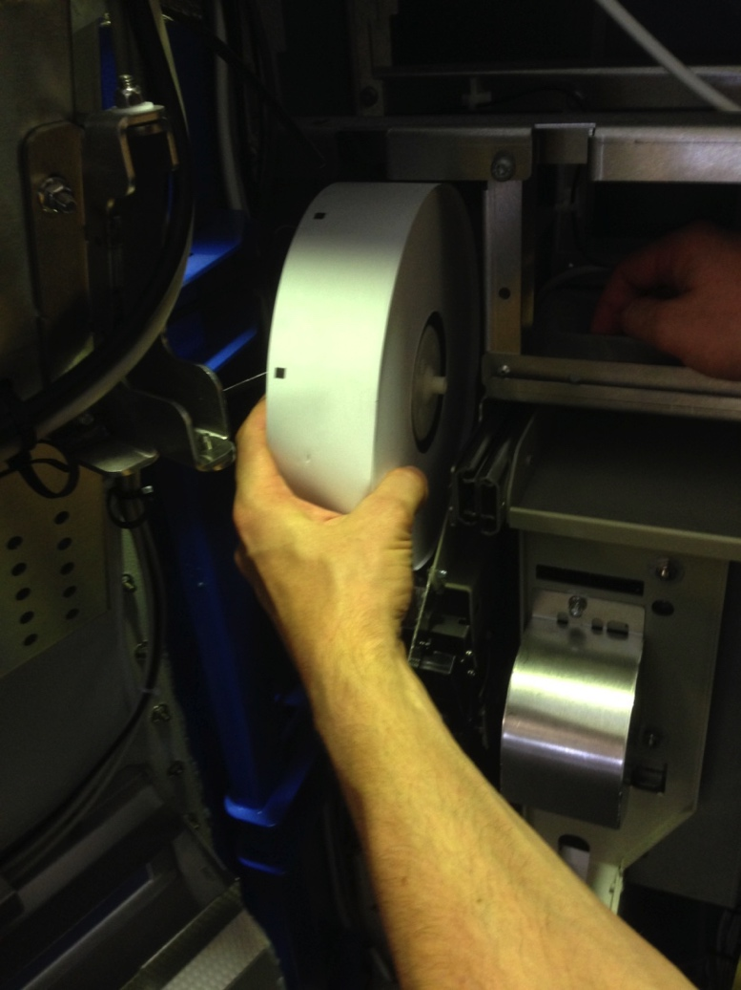
Replenish paper receipt roll - Galexio Machine
Slide the paper receipt roll into the slot

Slide 61
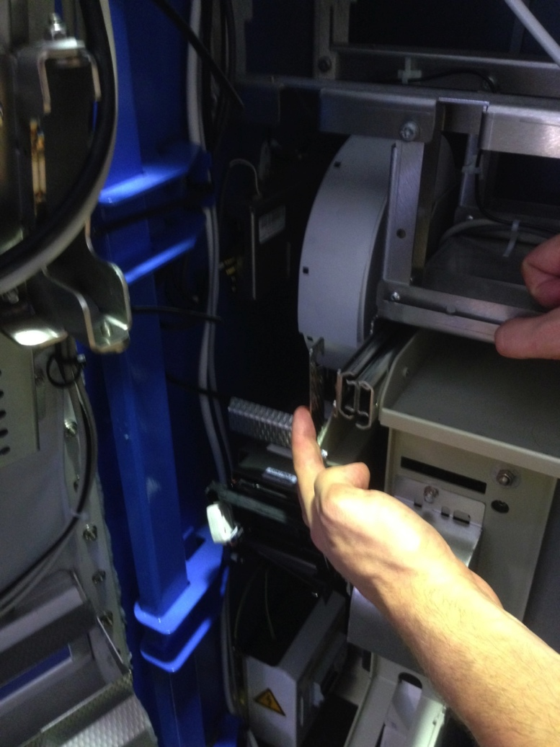
Replenish paper receipt roll - Galexio Machine
Rotate silver paper guide back up until latch locks back into place

Slide 62
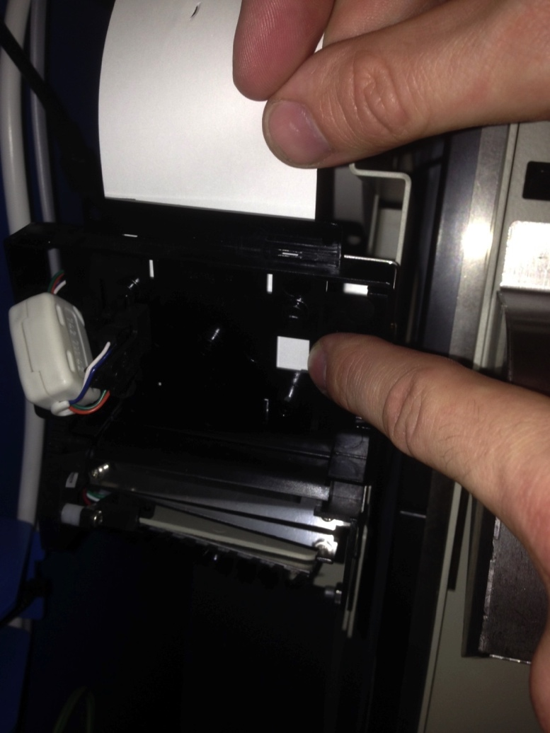
Replenish paper receipt roll - Galexio Machine
Feed the paper into the printer guide as far as possible You should see the paper appear in the small cutout window bottom right.

Slide 63
Replenish paper receipt roll - Galexio Machine
Unlatch the display by pressing the lever down and lifting slightly over latch and open fully Use the arrow buttons on the keypad to navigate the display

Slide 64
Replenish paper receipt roll - Galexio Machine
Select Paper Guiding

Slide 65
Replenish paper receipt roll - Galexio Machine
Select New Roll. The paper will automatically be pulled down into printer

Slide 66
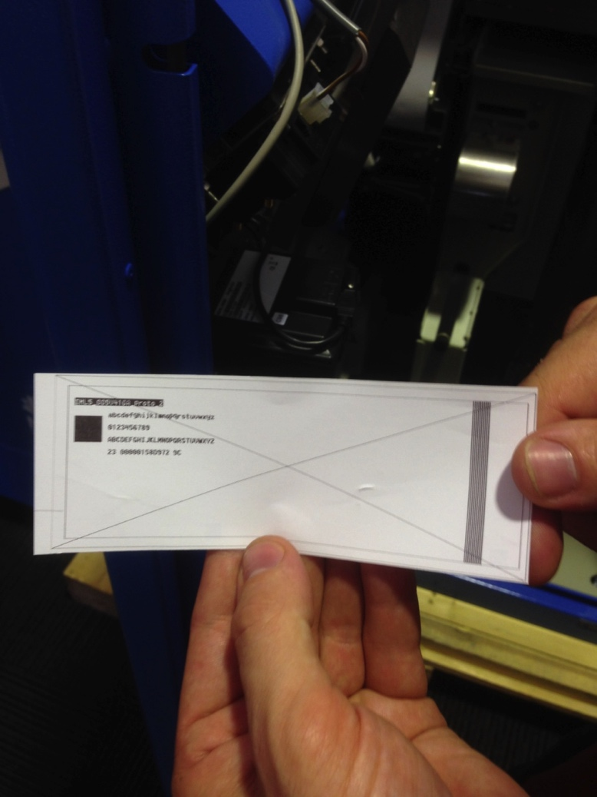
Replenish paper receipt roll - Galexio Machine
The display will briefly show “Printing test ticket”
Collect and check test paper receipt

Slide 67
Replenish paper receipt roll - Galexio Machine
Display refreshes. “Reload done. Test ticket printed” message will display
Press Enter

Slide 68
Replenish paper receipt roll - Galexio Machine
Maintenance of IML5 displays IML5 printer is the paper receipt printer
Select Previous Menu
Select Previous Menu

Slide 69
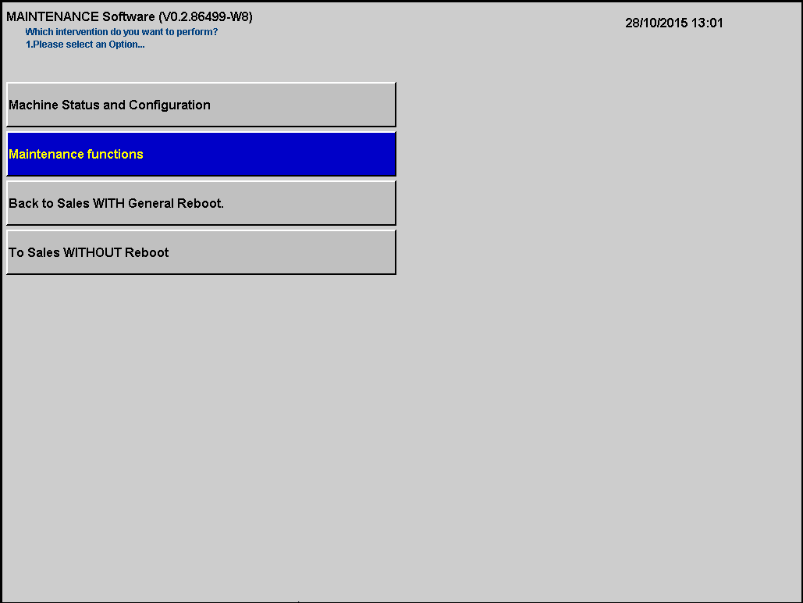
Replenish paper receipt roll - Galexio Machine
Main menu will display

Slide 70
Replenish paper receipt roll - Astreo Machine
Select Maintenance Functions

Slide 71
Replenish paper receipt roll - Astreo Machine
Select Maintenance of Iml5 printer LML5 Printer is the paper receipt printer

Slide 72
Replenish paper receipt roll - Astreo Machine
Select Reload Paper

Slide 73
Replenish paper receipt roll - Astreo Machine
Select Support RECEIPT (RECEIPT)

Slide 74
Replenish paper receipt roll - Astreo Machine
The Opal Top Up and Single Trip Ticket Machine will display the Support RECEIPT (RECEIPT) IML5 screen IML5 printer is the paper receipt printer
Now it is time to access the printer
Lock display back into place

Slide 75
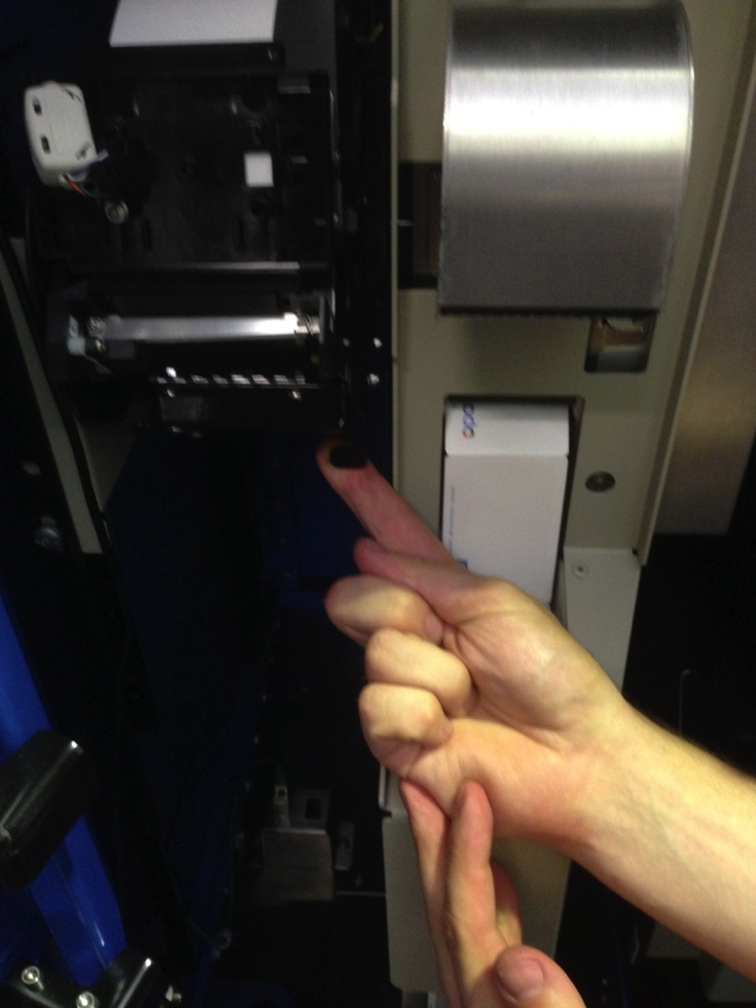
Replenish paper receipt roll - Astreo Machine
Press lever at bottom right of paper receipt printer towards you and lift down

Slide 76
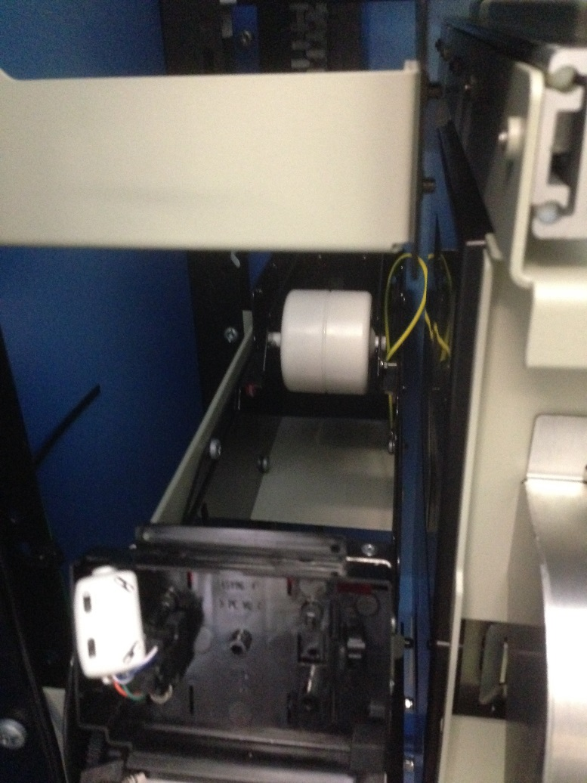
Replenish paper receipt roll - Astreo Machine
The paper receipt roll is now able to be removed
Lift up and remove empty spindle reel from printer and remove empty roll

Slide 77
Replenish paper receipt roll - Astreo Machine
Unpack new paper receipt roll and tear off the first layer or so to ensure that there is no glue or sticky residue on the paper

Slide 78
Replenish paper receipt roll - Astreo Machine
Insert spindle into new paper receipt roll

Slide 79
Replenish paper receipt roll - Astreo Machine
Ensure the replacement paper receipt roll end is facing forward and feeding from the top

Slide 80
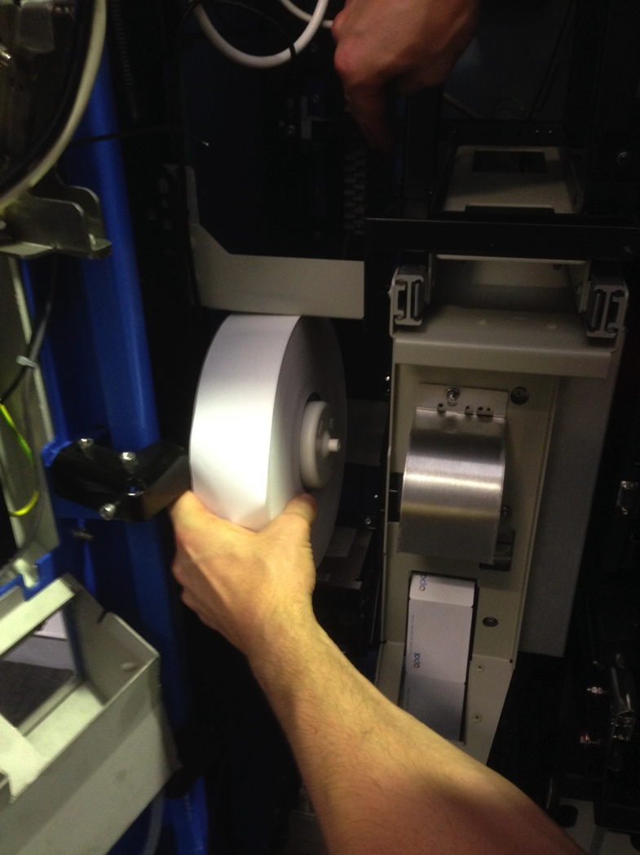
Replenish paper receipt roll - Astreo Machine
Slide the paper receipt roll into the slot

Slide 81
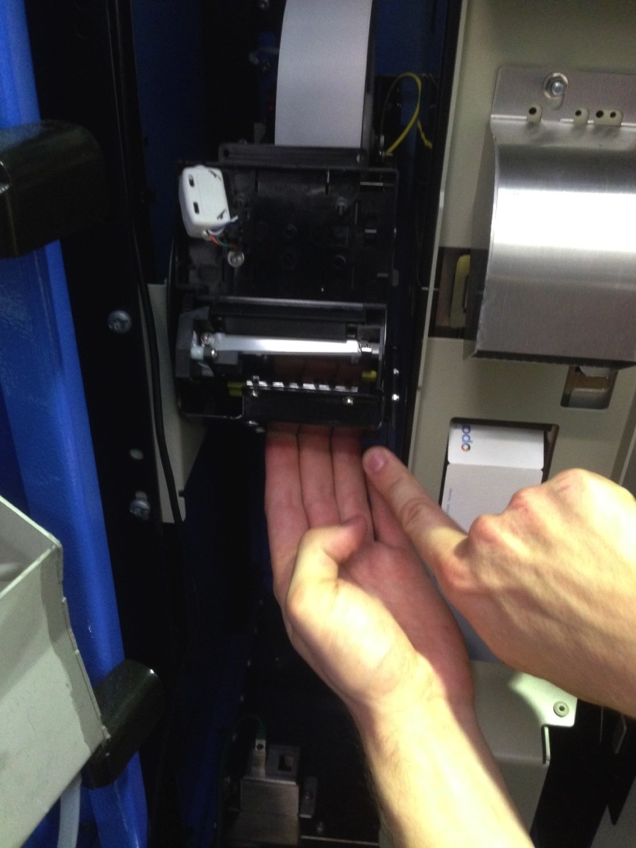
Replenish paper receipt roll - Astreo Machine
Raise printer module back up as far as it goes and press lever towards you to lock into place

Slide 82
Replenish paper receipt roll - Astreo Machine
Feed the paper into the printer guide as far as possible You should see the paper appear in the small cutout window bottom right.

Slide 83
Replenish paper receipt roll - Astreo Machine
Unlatch the display by pressing the lever down and lifting slightly over latch and open fully Use the arrows on the keypad to navigate on the display.

Slide 84
Replenish paper receipt roll - Astreo Machine
Select Paper Guiding

Slide 85
Replenish paper receipt roll - Astreo Machine
Select New Roll The paper will automatically be pulled down into printer.

Slide 86
Replenish paper receipt roll - Astreo Machine
The display briefly will display “Printing test ticket”
Collect and check test paper receipt

Slide 87
Replenish paper receipt roll - Astreo Machine
Display refreshes. “Reload done. Test ticket printed” message will display
Press Enter

Slide 88
Replenish paper receipt roll - Astreo Machine
Maintenance of IML5 displays
Select Previous Menu
Select Previous Menu

Slide 89
Replenish paper receipt roll - Astreo Machine
Main menu will display

Slide 90
TOPIC 7
Replenish Single Trip Tickets

Slide 91
Replenish Single Trip Ticket Stock - Galexio Machine
Select Maintenance Functions from the Main Menu

Slide 92
Replenish Single Trip Ticket Stock – Galexio Machine
Select Maintenance of Ims printer IMS Printer is the Single Trip Ticket printer

Slide 93
Replenish Single Trip Ticket Stock - Galexio Machine
Select Reload Paper

Slide 94
Replenish Single Trip Ticket Stock - Galexio Machine
Select Support SCC (SCC) SCC is the Single Trip Ticket module

Slide 95
Replenish Single Trip Ticket Stock - Galexio Machine
Select the appropriate stock to replenis
(either stock 1 or stock 2 although 1-4 displays)

Slide 96
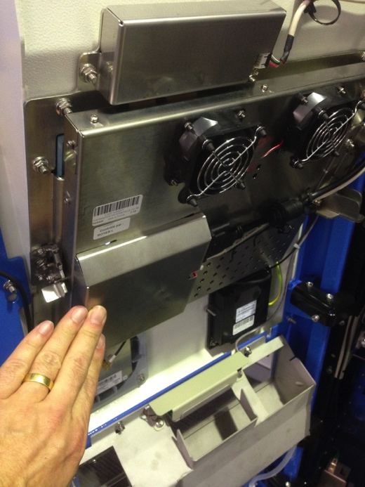
Replenish Single Trip Ticket Stock - Galexio Machine
Read instructions
Lock display back into place

Slide 97
Replenish Single Trip Ticket Stock - Galexio Machine
Pull out printer towards you
Remove empty box and discard

Slide 98
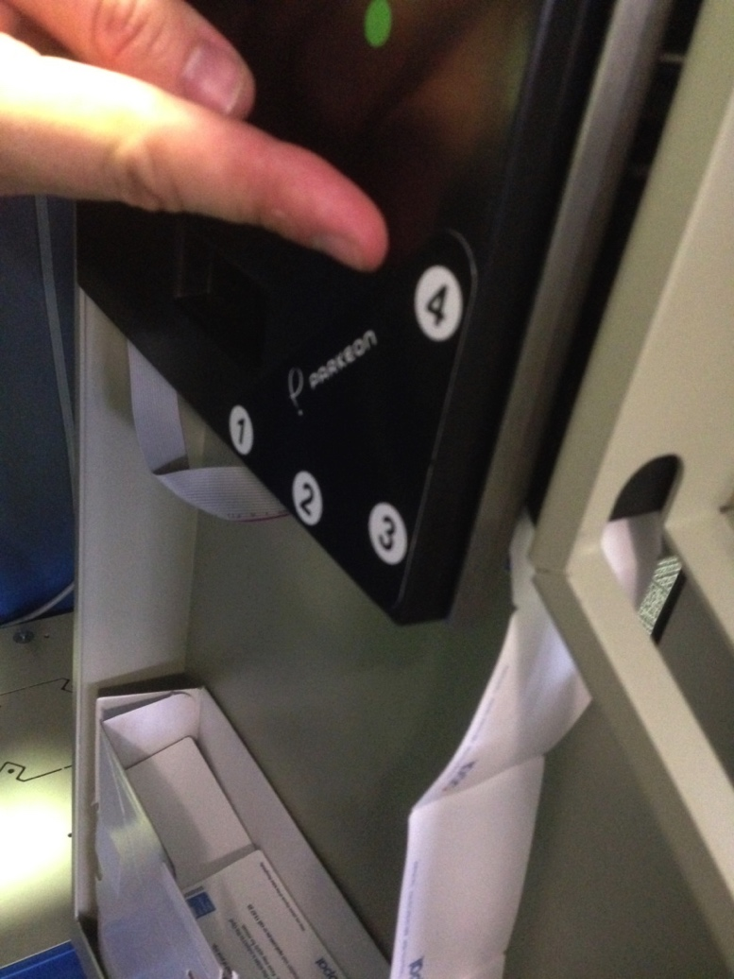
Replenish Single Trip Ticket Stock - Galexio Machine
There are 2 ticket stock slots that can be used Start at Slot 1 for back box and 2 for front.

Slide 99
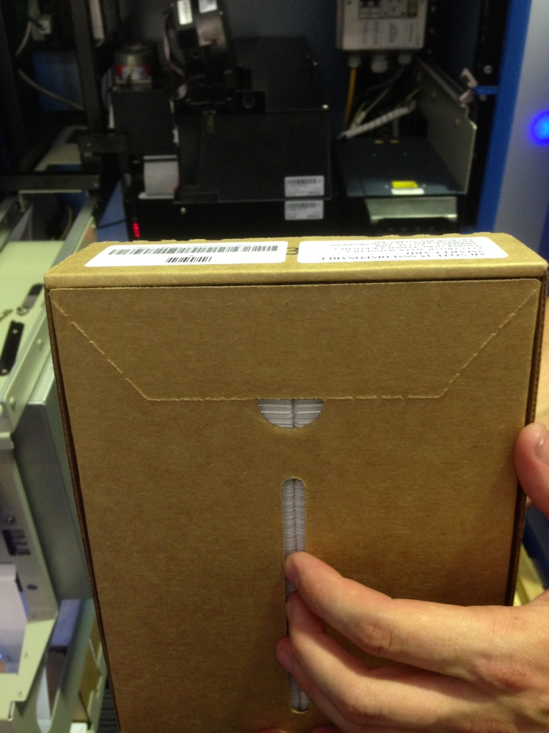
Replenish Single Trip Ticket Stock - Galexio Machine
Open up new box by tearing along the perforated edges at top of box

Slide 100
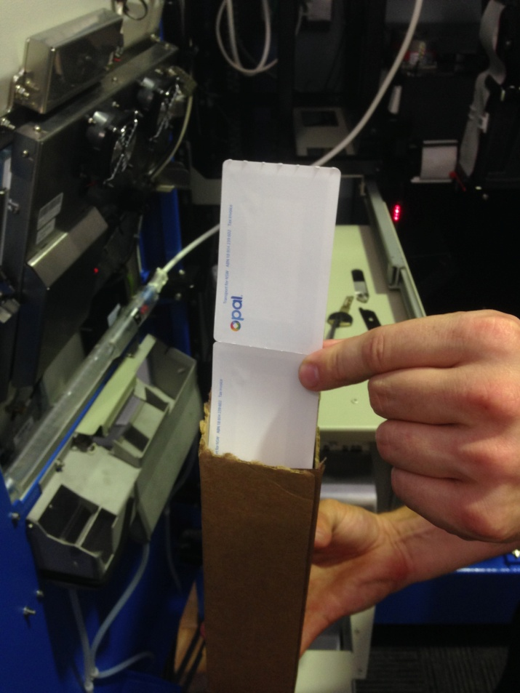
Replenish Single Trip Ticket Stock - Galexio Machine
Ensure new box has Opal logo on the left hand side at the bottom with white facing forward and place in tray

Slide 101
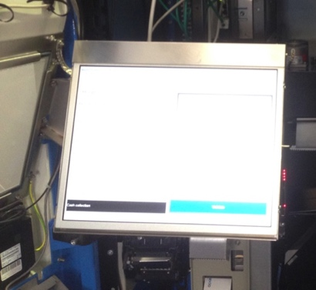
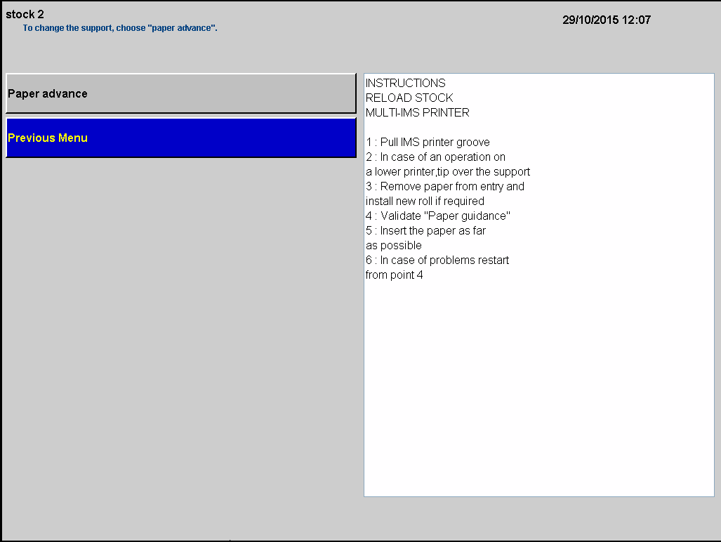
Replenish Single Trip Ticket Stock - Galexio Machine
Open display
Select Paper Advance to allow Single Trip Tickets to be fed into the printer

Slide 102
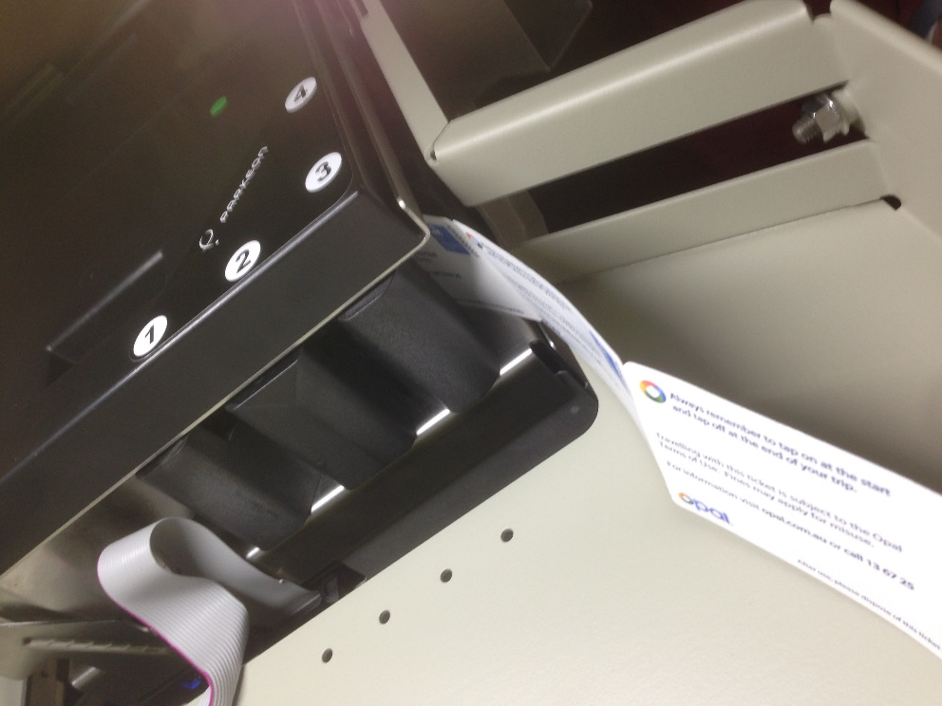
Replenish Single Trip Ticket Stock - Galexio Machine
You will hear the printer ready to grab the stock.
Feed the ticket stock through the slot – 1 and 2. The printer will grab tickets.

Slide 103
Replenish Single Trip Ticket Stock - Galexio Machine
Paper advance displays
Use the keypad to select new Roll

Slide 104
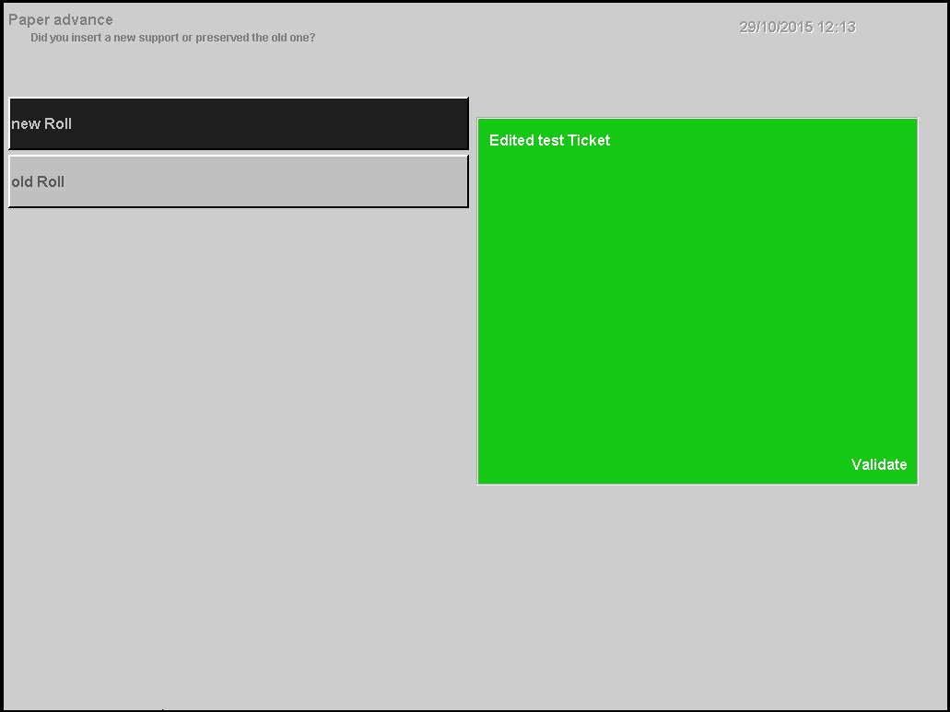
Replenish Single Trip Ticket Stock - Galexio Machine
Display refreshes and will show Edited test Ticket green box
Press Enter

Slide 105
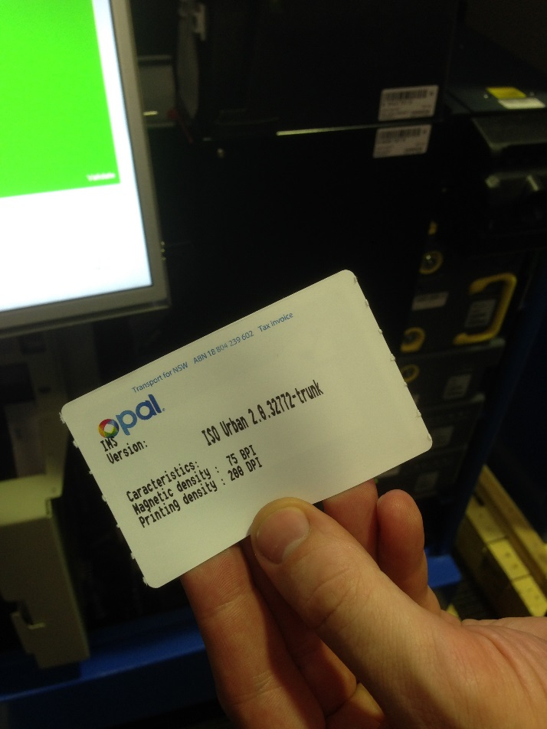
Replenish Single Trip Ticket Stock - Galexio Machine
Test ticket will drop from printer into the base of the machine

Slide 106
Replenish Single Trip Ticket Stock - Astreo Machine
From the Maintenance of IMS Printer screen, select Reload Paper on the keypad IMS printer is the Single Trip Ticket printer

Slide 107
Replenish Single Trip Ticket Stock - Astreo Machine
Select Support SCC (SCC) on the keypad SCC is the Single Trip Ticket module.

Slide 108
Replenish Single Trip Ticket Stock - Astreo Machine
Use the keypad to select the appropriate stock to replenish

Slide 109
Replenish Single Trip Ticket Stock - Astreo Machine
Instructions will display
Lock Display back into place to clear the way for removal of the printer

Slide 110
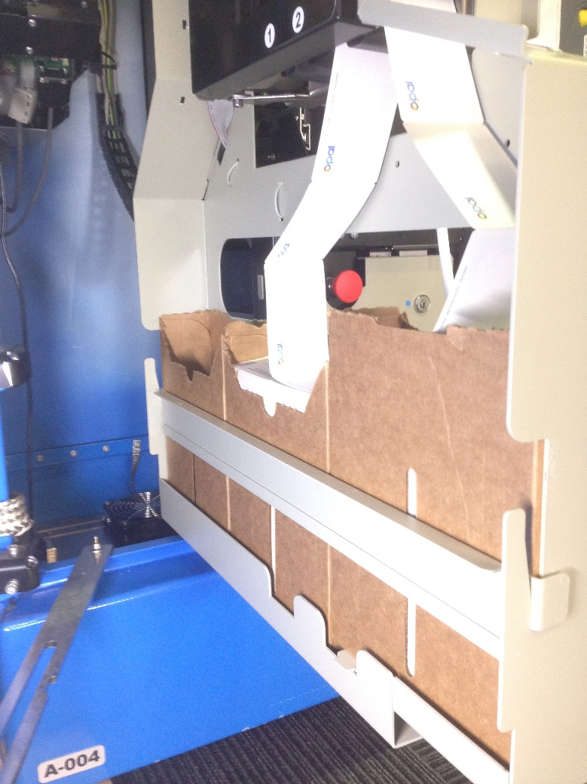
Replenish Single Trip Ticket Stock - Astreo Machine
Pull out printer towards you
Lift up guard that holds the boxes in place – by lifting front first. Remove guard and place on ground in a safe place
Remove empty box and discard

Slide 111
Replenish Single Trip Ticket Stock - Astreo Machine
There are three ticket stock slots that can be used Start at Slot 1 for back box, then 2 and 3.

Slide 112
Replenish Single Trip Ticket Stock - Astreo Machine
Open up new box by tearing along the perforated edges at top of box

Slide 113
Replenish Single Trip Ticket Stock - Astreo Machine
Ensure new box has Opal logo on the left hand side at the bottom with white facing forward and place in tray

Slide 114
Replenish Single Trip Ticket Stock - Astreo Machine
Open display
Select Paper Advance

Slide 115
Replenish Single Trip Ticket Stock - Astreo Machine
You will hear the printer ready to grab the stock
Feed the ticket stock through the slot – 1, 2 or 3. The printer will grab tickets.

Slide 116
Replenish Single Trip Ticket Stock - Astreo Machine
Paper advance displays
Select new Roll

Slide 117
Replenish Single Trip Ticket Stock - Astreo Machine
Display refreshes and will display Edited test Ticket green box
Press Enter

Slide 118
Replenish Single Trip Ticket Stock - Astreo Machine
Test ticket will drop from printer

Slide 119
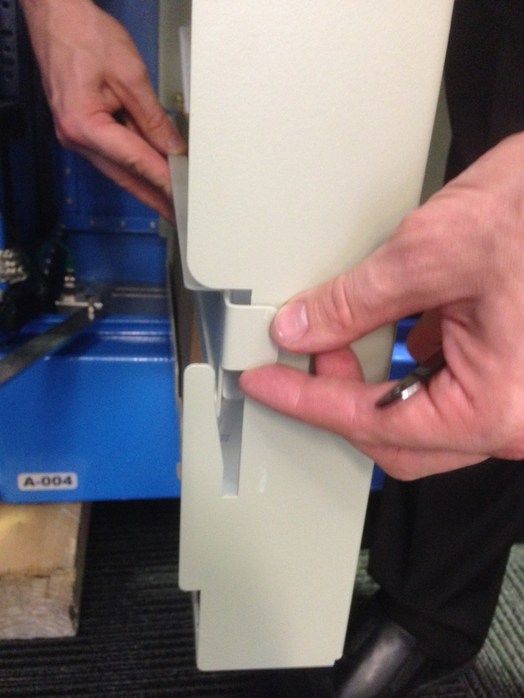
Replenish Single Trip Ticket Stock - Astreo Machine
Replace the guard back by hooking the back section first and then the front
Slide the guard down until it locks into place

Slide 120
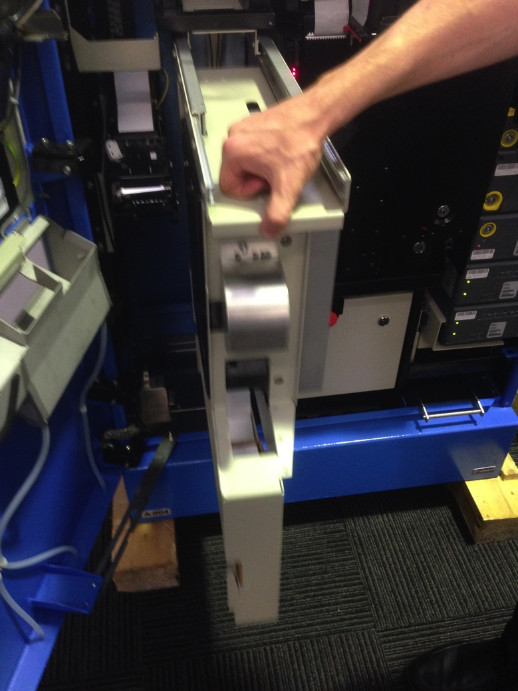
Replenish Single Trip Ticket Stock - Astreo Machine
Push the printer back into the Opal Top Up and Single Trip Ticket Machine and open the montior

Slide 121
Replenish Single Trip Ticket Stock - Astreo Machine
Select Previous Menu until you return to the main menu

Slide 122
Empty IMS reject bin
Select Maintenance Functions

Slide 123
Empty IMS reject bin
Select Maintenance of Ims printer IMS Printer is the Single Trip Ticket printer

Slide 124
Empty IMS reject bin
Select Empty IMS reject bin IMS reject bin is the Single Trip Ticket reject bin
Select YES

Slide 125
Empty IMS reject bin
Display refreshes and will show instructions

Slide 126
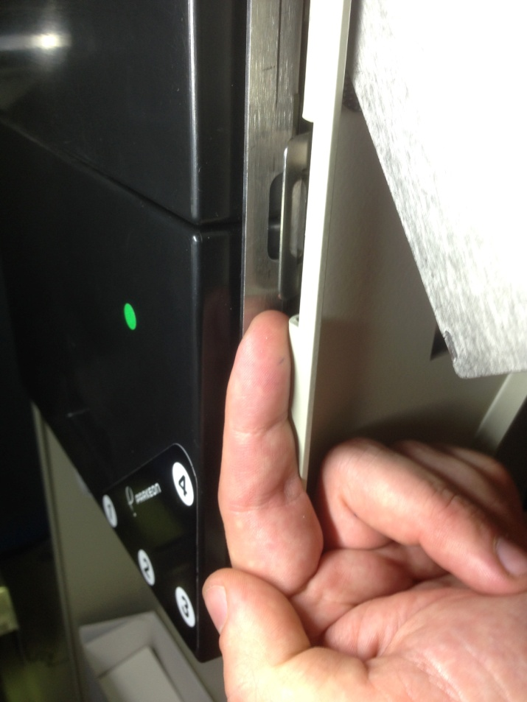
Empty IMS reject bin
Pull latch forward to allow the black printer door to open

Slide 127
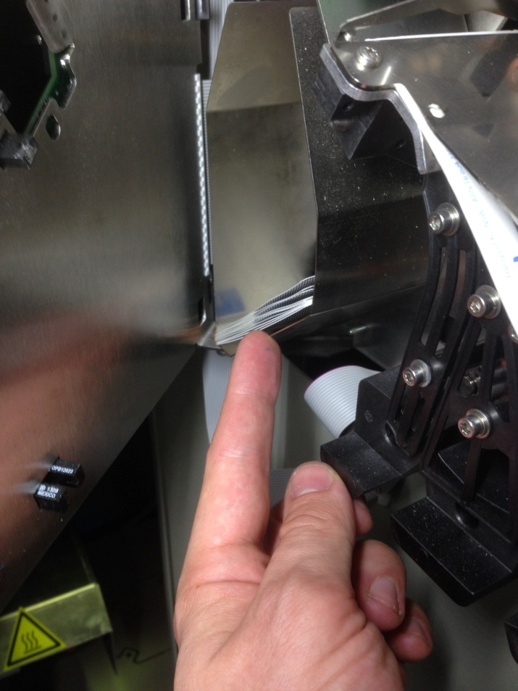
Empty IMS reject bin
Remove rejected tickets from bin and discard
Close printer door
Slide printer back into place

Slide 128
Empty IMS reject bin
Open display and use keypad
Press Enter

Slide 129
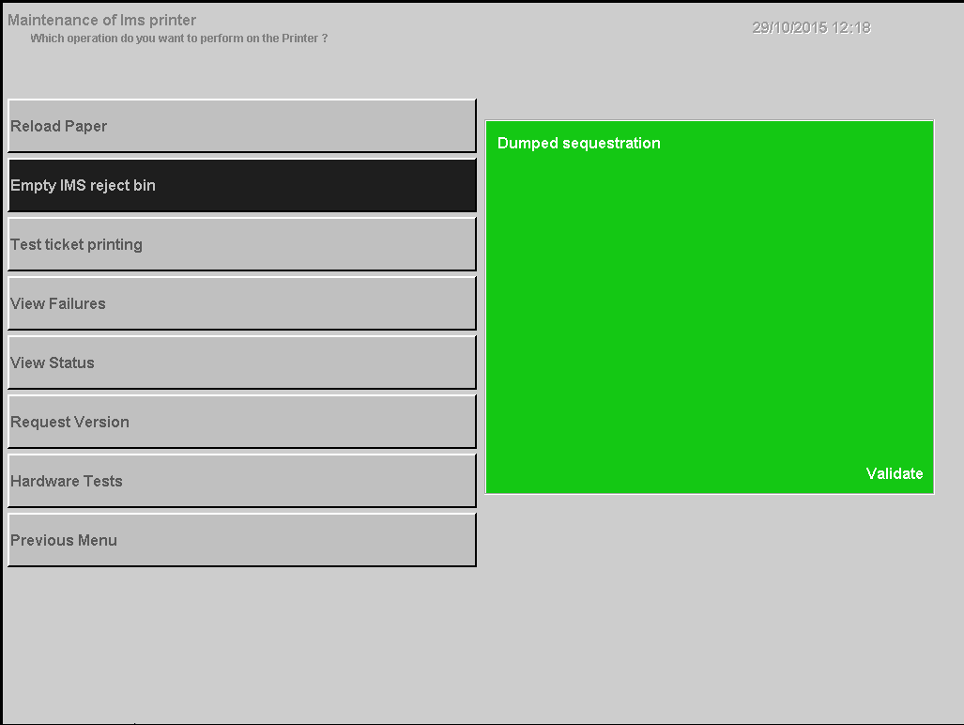
Empty IMS reject bin
Dumped Sequestration displays
Press Enter
Select Previous Menu
Select Previous Menu

Slide 130
TOPIC 8
Close and lock Opal Top Up and Single Trip Ticket Machine

Slide 131
Return Machine to Sales Mode
Main Menu will display
Select To Sales WITHOUT Reboot and press Enter

Slide 132
Return Machine to Sales Mode
Are you sure to return to sales WITHOUT reboot? message will display
Select YES then press Enter

Slide 133
Return Machine to Sales Mode
Display refreshes. It is now time to put the display back in place and make sure the latch is on

Slide 134
Close Door
Use foot to gently lift the lock bracket at bottom of door then close the door
Galexio
Astreo

Slide 135
Lock Opal Top Up and Single Trip Ticket Machine - Galexio Machine
Push latch on front top right hand inside of the paper receipt tray down to allow the lock to be visible
Close and lock the Opal Top Up and Single Trip Ticket Machine door by turning key fully clockwise
Remove the key and store in a safe place

Slide 136
Lock Opal Top Up and Single Trip Ticket Machine - Galexio Machine
Display updates

Slide 137
Lock Opal Top Up and Single Trip Ticket Machine - Galexio Machine
The temporary close message is displayed briefly before returning to the Customer Home Screen

Slide 138
Lock Opal Top Up and Single Trip Ticket Machine - Galexio Machine
Opal Top Up and Single Trip Ticket Machine is now back in Sales Mode

Slide 139
Lock Opal Top Up and Single Trip Ticket Machine - Astreo Machine
On bottom lock, use the supplied tool to raise latch to allow the lock to be visible. Insert key into lock and turn fully clockwise
On top lock, use the supplied tool to raise latch to allow the lock to be visible. Insert key into lock and turn fully clockwise
Remove the key and store in a safe place

Slide 140
Lock Opal Top Up and Single Trip Ticket Machine - Astreo Machine
Display updates

Slide 141
Lock Opal Top Up and Single Trip Ticket Machine - Astreo Machine
The temporary close message is displayed briefly before returning to the Customer Home Screen

Slide 142
Lock Opal Top Up and Single Trip Ticket Machine - Astreo Machine
Opal Top Up and Single Trip Ticket Machine is now back in Sales Mode

Slide 143
TOPIC 8
Assessment

